Slide 1

OOP Mini Project Presentation
Topic: 6.Ô Ăn Quan
Group: 16

Slide 2
Content
CONTENT
Member and Assignment
Problem Statement
Use case diagram
Class diagram
OOP Technique explanation
Project Demo

Slide 3
I. Member and Assignment
Dinh Ngoc Lap Thanh – 20226000
Design detail Class Diagram and Use case Diagram
Write project Report
Responsible for all project source code
Exception in thread "main" java.lang.ArrayIndexOutOfBoundsException: Index 1 out of bounds for length 1

Slide 4
II. Problem Statement
Design a functioning game with main screen that include:
Start: start the game
Exit: exit the program with confirmation from user
Help: display game guideline
In the game screen:
A game board with 10 square tiles holding 5 “dan” each and 2 semi circles holding 1 “quan” each.
Each turn must signify which player’s turn it is.
Players can select square and direction to spread gems. If condition meet, he/she will collect the gems in the consecutive squares according to the game’s instruction.
A notification of the winner when the end game condition is met.

Slide 5
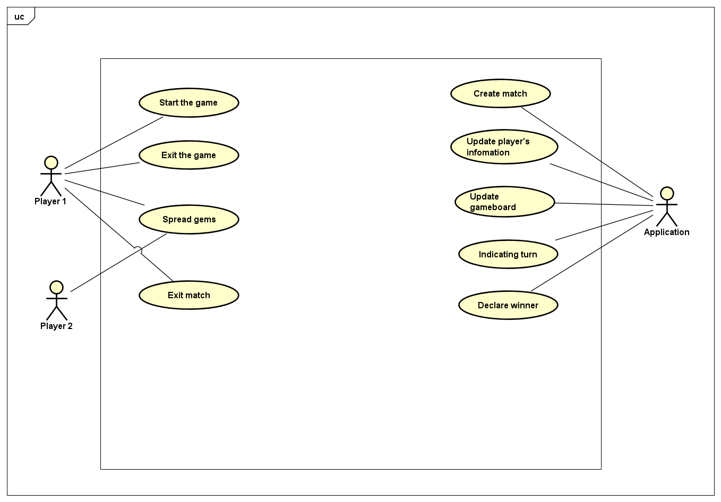
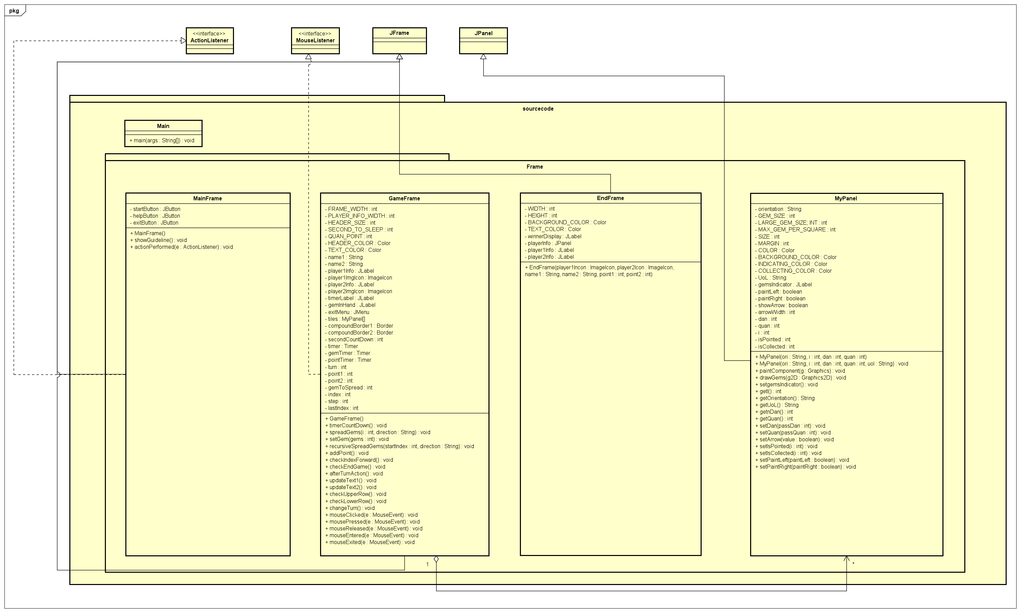
III. Use case diagram

Slide 6
IV. Class diagram

Slide 7
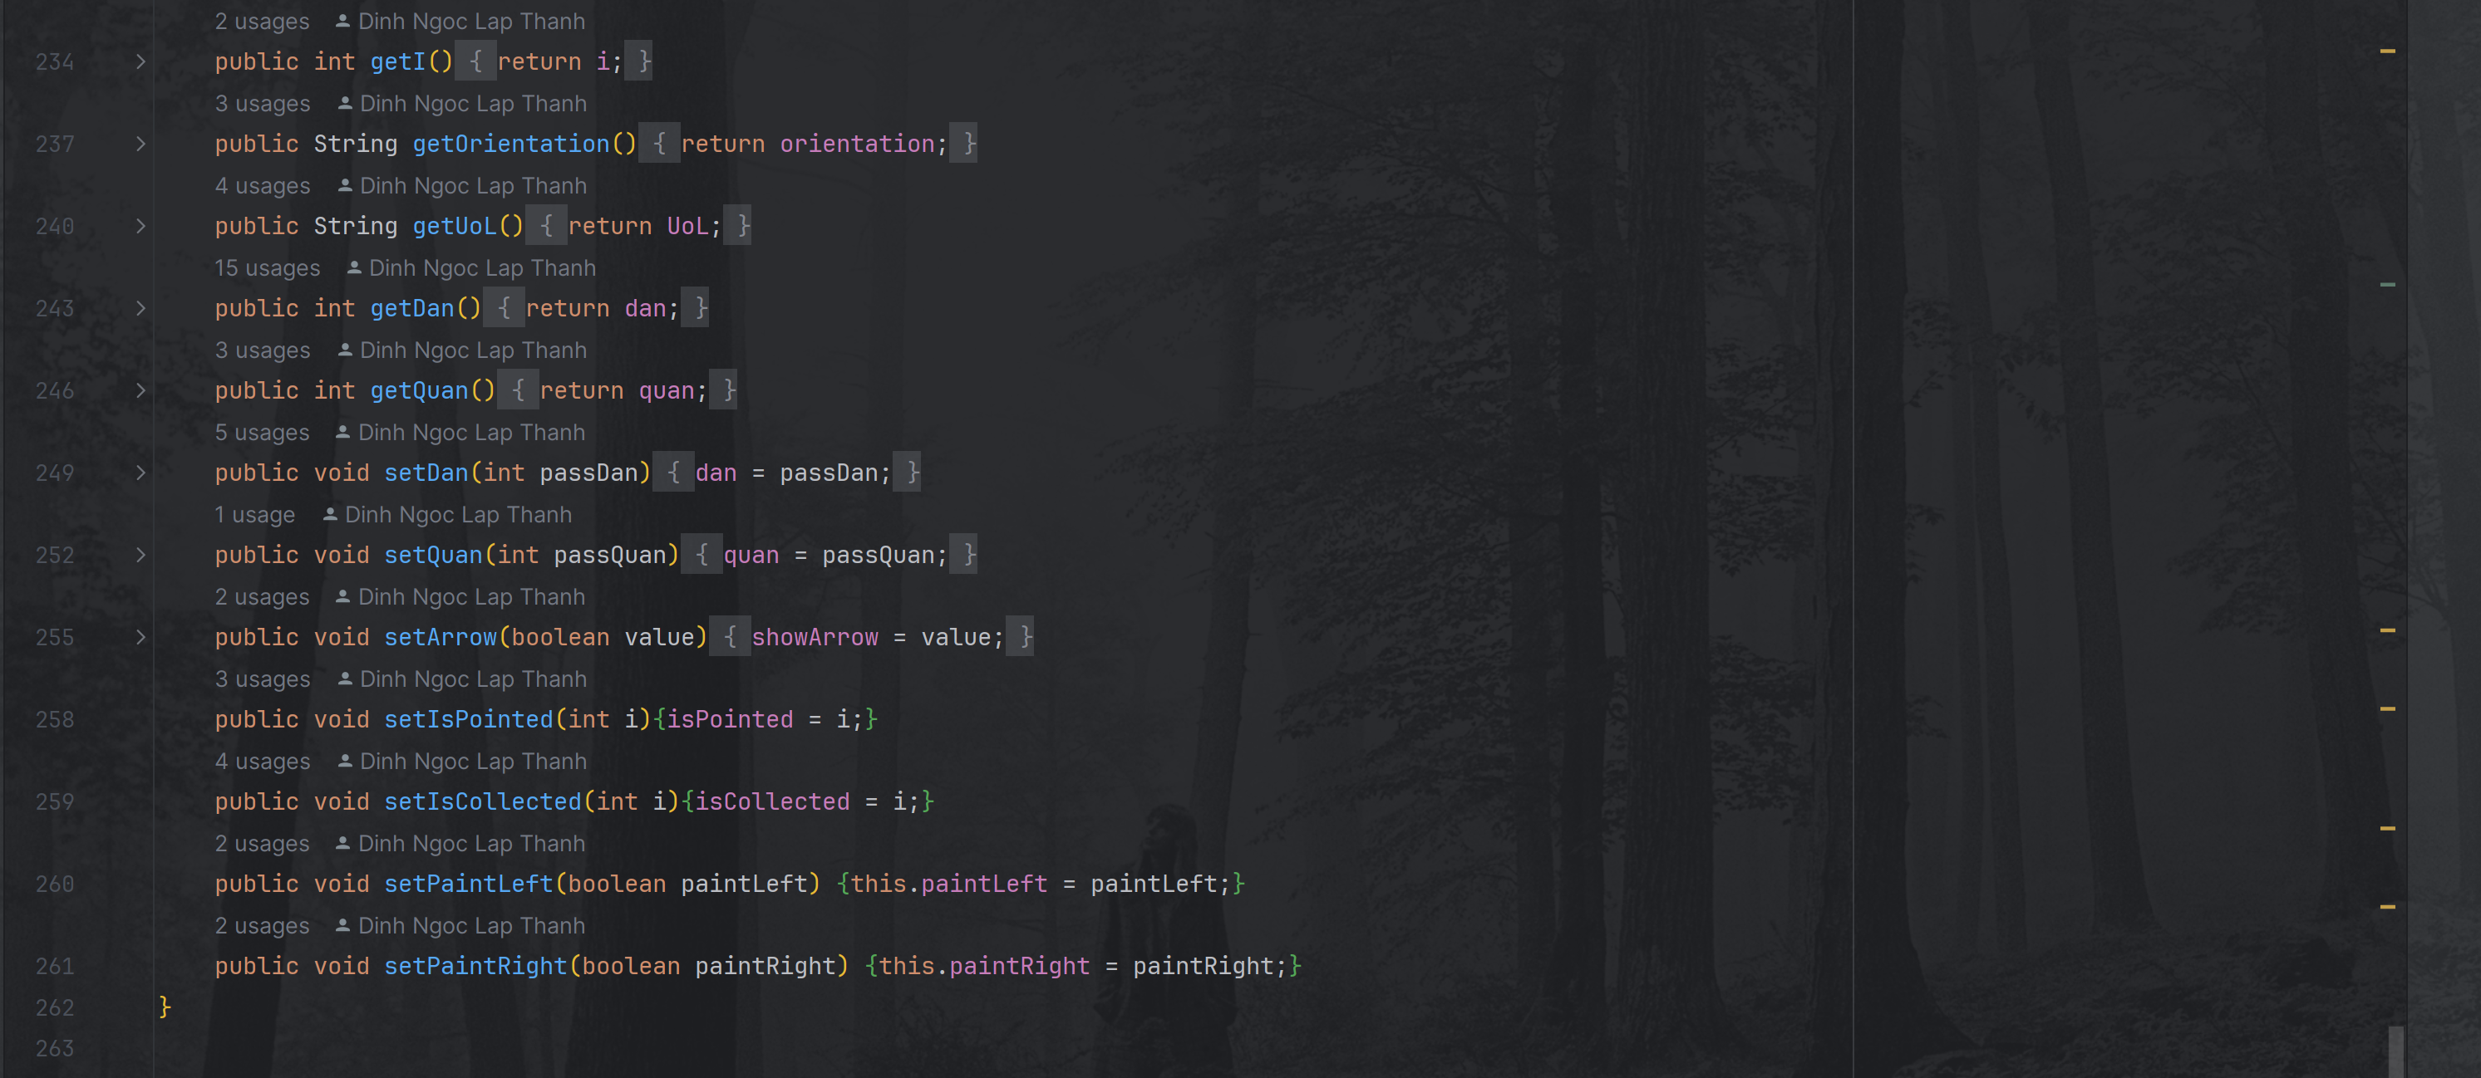
V. OOP Technique explanation
Abstraction and Encapsulation
To prevent unwanted data access, we utilize encapsulation to return and modify data only when called.

Slide 8




V. OOP Technique explanation
II. Aggregation and Inheritance
Class MainFrame, GameFrame inherit from class JFrame.
Class MyPanel inherits from class JPanel.
Create a modifiable new class that still have the property of its parent.
Class GameFrame also use objects of class MyPanel as its member to initialize the gameboard.

Slide 9

V. OOP Technique explanation
III. Abstract class and Interface
Class MainFrame implement interface ActionListener and override its method.
Class GameFrame implement interface MouseListener and override its methods.
Class MyPanel also override the existing method paintComponent in its parent class, JPanel

Slide 10

V. OOP Technique explanation
IV. Polymorphism
Compile–Time polymorphism:
Class MyPanel utilizes multiple constructors for different sets of parameters required.
- Runtime polymorphism:
Class MyPanel override the existing method paintComponent in its parent class, JPanel.

Slide 11
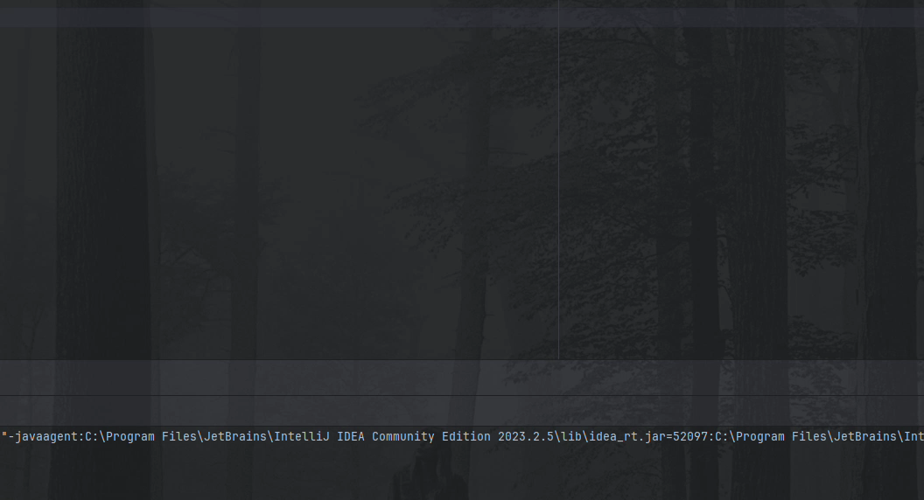
VI. Project Demo

